Slide 1

Welcome to Year 2
The Southwater Infant Academy
“Growing, Learning and Succeeding Together”
September 2026

Slide 2
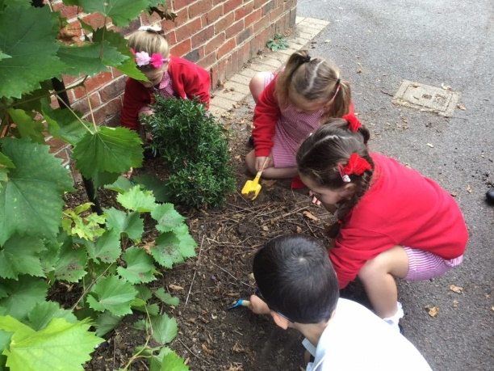
Settling in to Year 2
Thank you for helping to build up the children’s confidence to make the transition from Year 1 to Year 2, and for helping your child to come straight into school.
The children have settled so well to their new classrooms. We have all enjoyed sharing and working on their transition topic 'The Secret Sky Garden' that they started in Year 1.

Slide 3
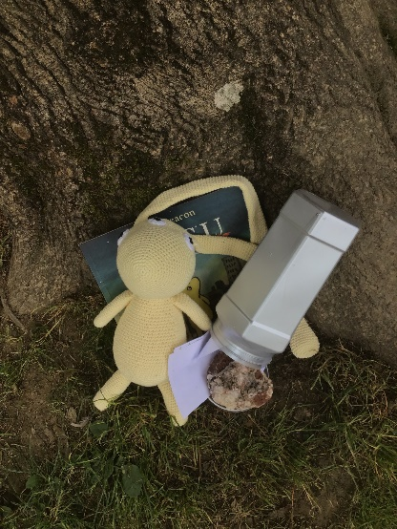
The Curriculum
In Year 2 we teach the revised Southwater Infant Academy curriculum, which covers the 2014 Primary National Curriculum.
Our curriculum has been developed for our children, linking with the Primary Curriculum, and equipping them with the skills required to succeed in our ever-changing world.
https://www.gov.uk/government/publications/national-curriculum-in-england-primary-curriculum
Our topics are as follows:
    Autumn Term - To Infinity and Beyond
    Spring Term - World Explorers
    Summer Term – Heroes and Champions

Slide 4
English
English is taught throughout the whole school curriculum. We have separate lessons for spelling (including phonics), handwriting and reading alongside our main English lesson where we are developing or writing skills. We also provide opportunities throughout the whole curriculum to develop vocabulary and apply our reading and writing skills.
Children’s speaking and listening skills are developed through activities such as drama and role play.

Slide 5
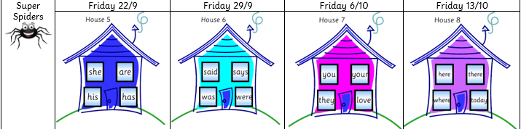
English
From next week, your child will bring home spellings to learn. To keep consistency between Year 1 and Year 2 we are going to be sending home 4/5 word houses, buses or rockets for the children to learn and practice over that half a term. In the last week before a half term, we will test the children on their group of word houses/buses/rockets.
These words are aligned with the spelling expectations laid out in the National Curriculum as well as being some of the most frequently used words. It is important that your child learns to write them fluently. All the word mats can be found on the school website or speak to your class teacher for a copy.

Slide 6

Reading
Your child will have been sent home with a yellow reading journal.
Books will be changed on Thursdays. They will receive a phonics or colour banded book to read to you at home, as well as a sharing book which we’d encourage you to read together.
The Reading journal aims to increase and improve communication between the Academy and parents. Children will be required hand in their journals on Friday and it will be checked and initialled by an adult each..
Your child’s teacher or teaching assistant will listen to your child read often. This could be individually, in a small group or as part of whole class reading sessions.

Slide 7
Reading
Please continue to read daily at home with your child for at least 10 minutes every day.
There is also an optional section for your children to complete in their yellow journals should they wish to draw or write about a book they have read.
It has been proven that parents are the most important reading role models for children and young people. (National Literacy Trust, Reaching Out with Role Models, April 2009) so PLEASE also spend some additional time reading to your children each day.
We will be expecting children to take part in the SIA reading challenge again this year. This can be done with books from school or home. Please record these in your child’s reading journal. Rainbow, bronze, silver and gold awards will be presented to children when they achieve these reading goals.

Slide 8
Reading
When reading with your child at home please focus on these areas:
Fluency
Expression
Discussion of the text and individual words and phrases
Questions about the story, including inferred questions.

Slide 9

Mathematics
We use a Maths Mastery approach across the Academy linked to the NCETM.
We use many resources such as; Rekenrek, number lines, Multilink and Numicon to help support learning.
Mathematical challenges will continue to be sent home every fortnight. Please can children have their homework books in their bookbags to be able to send this home. These aim to support your child’s mathematical development.
The children practise mental calculations on a daily basis.

Slide 10
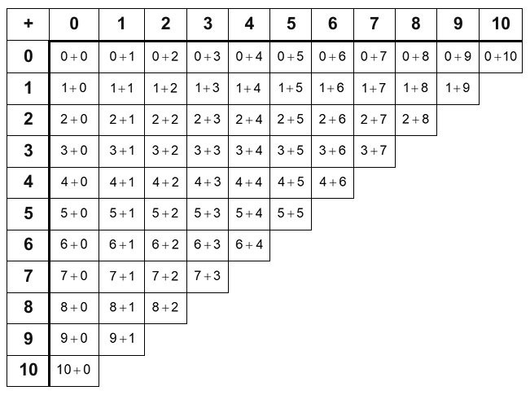
Mathematics
These are the number facts that your child should be able to recall without using fingers or counting on.
6 + 2 = 8
2 + 6 = 8
8 - 2 = 6
8 - 6 = 2

Slide 11

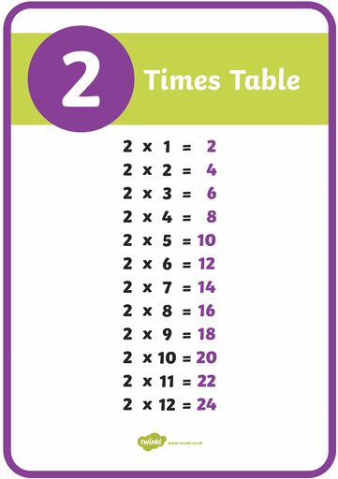
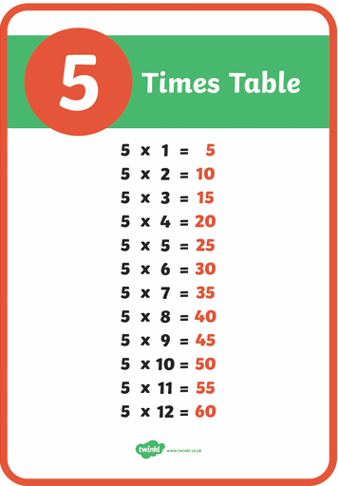
Mathematics
Children should also know the multiplication and division facts for the 2, 5 and 10 times table.

Slide 12
Yellow Wing Assessments
Children are assessed and their progress monitored regularly by class teachers. This enables us to ensure that all children are making progress and that the next steps in their learning are planned for.
Assessment is an ongoing process and will take place as part of daily lessons and end of unit activities. Unlike previous years, Year 2 children will not take KS1 SATs however to ensure parity, and a smooth transition to Year 3, recognised exemplar resources will help inform our judgements.
Children who did not take or pass the phonics screening check in Year 1 will be required to take it in June. Class Teachers will be in touch later in the year if this applies to your child.
We will hold parent consultation evenings in the Autumn and Spring Term and you will receive a report at the end of the Summer Term.

Slide 13
How are children supported in their learning in Yellow Wing?
Each class teacher plans and differentiates work to meet the needs of every child. They provide supported and extended activities to enable the children to meet and exceed their potential.
A range of groups are provided, dependent on the needs of the children. These include: Support from our ELSA and Thrive Practitioners and small group in class interventions to either extend or support where necessary.
https://www.southwaterinfantacademy.co.uk/page/?title=Interventions+Area&pid=76

Slide 14


Tapestry
We are delighted that Tapestry will continue across Key Stage 1 to reflect work being recorded in individual subject books.
Please do comment on the pictures and videos that we upload.
If you do not have time to comment but have seen
the upload please click the ‘like’ button so we
know it has been seen.

Slide 15
Behaviour
At The Southwater Infant Academy we believe that positive behaviour management:
  Is value led
  Sets high expectations
  Establishes and maintains clear boundaries
  Rewards positive behaviour
  Uses reasonable consequences and restorative justice
The Academy Values are known and respected by the school community and are displayed in each classroom and throughout the academy. They are taught in assemblies and throughout the PSHE programme and are revisited with the children at every opportunity.
At Southwater Infants, we are working towards becoming a restorative school, which is one which takes a restorative approach to resolving conflict and preventing harm.
Restorative approaches enable those who have been harmed to convey the impact of the harm to those responsible, and for those responsible to acknowledge the impact and take steps to put it right.

Slide 16
Rewards
At Southwater Infants all members of staff recognise, model and celebrate the academy values at all times around the academy through informal and specific praise. Wherever possible, children’s best efforts will be celebrated through praise, display and performance. As a class we work together towards a class treat at the end of a half term, we have value points and certificates in assembly.
Consequences of inappropriate behaviour
At Southwater Infants we recognise that there are, on occasion, times that mistakes can and will be made. The children are learning their way in the world and will need help and guidance at times. At Southwater Infants, our aim is to be proactive in supporting children to learn from mistakes and take ownership of their own choices. This may mean accepting consequences for these actions.
At Southwater Infants we use a restorative approach to resolving and repairing conflict and tackling challenging behaviour. All consequences have a learning outcome and aim to teach children that there are always repercussions for poor choices and inappropriate behaviour. Our goal is to help the children learn to make informed and positive decisions and to choose a better way.

Slide 17

Transition
We have an excellent relationship with the junior academy and work with them to ensure that the children have the best possible move up.
Activities to support transition in the past have included:
Watching the Year 3 Christmas Show
Year 3 teachers visiting Yellow wing
Special Assemblies
Extra transition days either whole class or small group.
Transition work/topics.
Teacher to teacher handovers

Slide 18
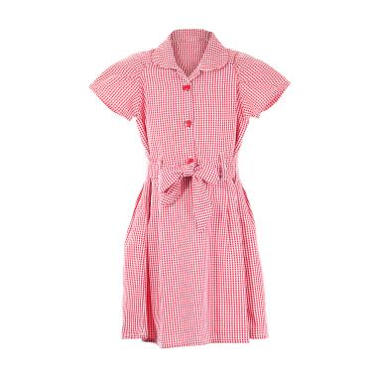
Free School Meals and Pupil Premium
The government has announced that the eligibility criteria for free
school meals will change from 1 September 2026.
All children who live in a household that receives Universal Credit can
get free school meals.
There will be 2 types of benefits-related free school meals (FSM).
Targeted free school meals
Children can get targeted free school meals if their household receives Universal Credit and earns £7,400 a year or less.
Children who receive targeted free school meals can also:
take part in the Holiday Activities and Food (HAF) programme
help our school receive extra Pupil Premium funding
Expanded free school meals
Expanded free school meals are for children whose household receives Universal Credit but does not qualify for targeted free school meals.
Children in this group can receive free school meals, but they cannot access the extra support linked to targeted free school meals.

Slide 19
Free School Meals and Pupil Premium
Targeted free school meals in all schools and academies are available to pupils in receipt of, or whose parents are in receipt of one or more of the following benefits:
Universal Credit
Income-based Jobseeker's Allowance
Income-related Employment and Support Allowance
Support under Part VI of the Immigration and Asylum Act 1999
The guaranteed element of state Pension Credit
Once your child has a free school meal status, either Targeted FSM or Expanded FSM, they will keep that status until the end of that school year.
Your child's eligibility will be checked by West Sussex every year before the start of the new school year. If West Sussex do not have the information they need, they may ask you to provide updated details.
If your child does not qualify for benefits-related free school meals, they can still get Universal Infant Free School Meals (UIFSM).
If your child receives UIFSM and also qualifies for Targeted FSM, it is important to register for Targeted FSM.
Registering helps our school claim pupil premium funding. This extra funding gives the additional funding to support your child with their learning and wellbeing. We can help with uniform, clubs, trips and visits, and classroom support. The application process is really simple, and we can help if you get stuck with it.

Slide 20
House Keeping
Remember hot meals are available free for every child.
Please visit the Easy Lunch website to view the current menus and book your meal choices:
You will need your school grid username and password. If you do have this please contact the office.
www.theeasylunchcompany.co.uk
If your child brings a packed lunch from home, please ensure you only include healthy food in your child’s lunchbox, no sweets or chocolate. Please note we are a nut-free school.

Slide 21
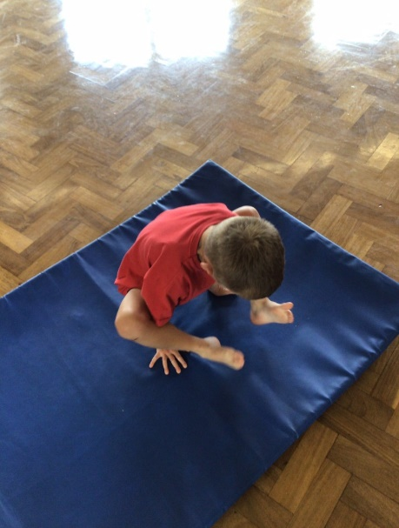
House Keeping
Each class will have 2 P.E sessions per week, one indoor and one outdoor. On these days children need to come to the academy dressed in their PE kit. If the weather is cold please can children wear jogging bottoms and academy hoodie or fleece. Children need to be wearing trainers. Please remove any earrings on PE days or ensure they are taped over.
PLEASE NAME EVERYTHING.
Please ensure children bring a named water bottle and coat every day to school as the weather becomes more unpredictable.
Don’t forget that the Academy office opens at 8.30am. If your child is going to be late or absent for any reason, please ring the Academy office after this time so that the class teacher can be informed. You can also email the academy office to let us know.
Please remember that holidays during term time
will not be authorised.

Slide 22
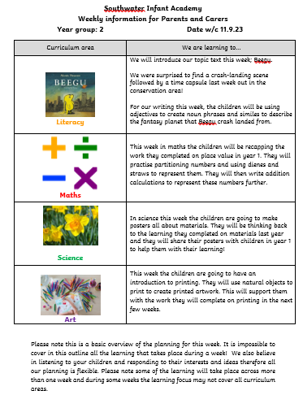
Parent Overviews
We will upload a ‘Parent Overview’ to the school website each week which will give you an idea of the learning planned for each area and allow you to support at home.

Slide 23
Fundraising
We are always incredibly grateful for any help in providing our children with the best possible resources to enhance their learning experiences.
We have an Amazon Wish list, items for each year group can be found here http://amzn.eu/7LFxzGp
The PTFA always welcomes help with any fundraising initiatives that they run. Parents and carers can be involved in lots of different ways, so please do get in touch with them if you are able to spare even a few minutes of your time. The funds the PTFA raise are vital in ensuring we can continue to provide resources and experiences to enhance and improve the children's learning.

Slide 24
Thank you!
Thank you so much for your ongoing support. We look forward to a fantastic year with your children in Yellow Wing!
If you are interested in helping out in school with reading, or any other activities please speak to your child’s class teacher as we are always eager for any support. We can arrange for you to have a DBS check.
As always if you have any questions or concerns, please arrange a time to speak with your child’s class teacher by phoning the office or arranging a suitable time with the class teacher at the classroom door.

