Slide 1

Welcome to Year 1
The Southwater Infant Academy
“Growing, Learning and Succeeding Together”
September 2026

Slide 2
Settling in to Year 1
Thank you for helping support your child on making the transition to Green Wing and for encouraging your child’s independence to come straight into school. It is always a pleasure each year getting to know new faces and personalities!
Important messages can be communicated to the staff at drop off, pick up, tapestry or via the office. If it is a matter of urgency or you require a meeting please contact the academy office.

Slide 3
The Curriculum
Our curriculum at the Academy has been developed for our children, linking with the Primary Curriculum, and equipping them with the skills required to succeed in our ever-changing world.
Our topics for the year are…
Autumn | Spring | Summer
Wild and wonderful | Didgeridoos and kangaroos | Once upon a tale
London Calling | This is me | Southwater’s past

Slide 4
Homework
Sent home on a Friday. Please return for the following Thurs.
This week on Friday your child will be bringing home spellings to learn. Word houses, word buses or rockets will be stuck into their homework books in sets to be practised at home. Teachers/TA’s will check and mark these on a weekly basis.
Spellings will be checked at the end of each half term.
We will give you notice so you can practise at home.
At the back of your child's homework book will also be the word houses, buses or rockets that they can currently read. These have a coloured dot next to them. Please continue to practise any that aren't dotted. We will assess these at the end of term.
Thank you in advance!

Slide 5
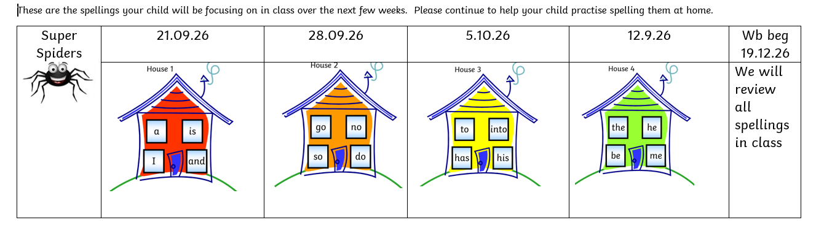

Slide 6
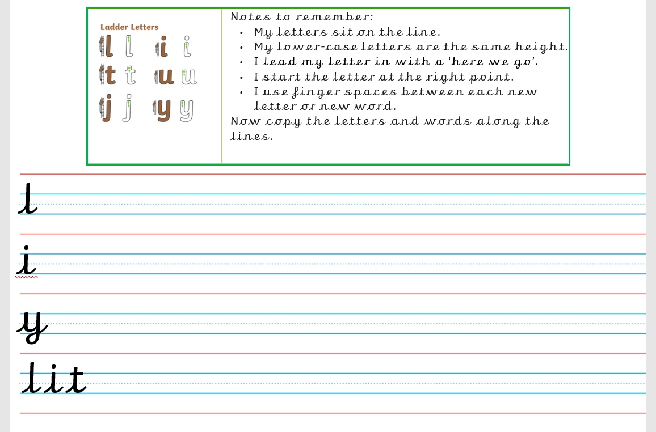

Slide 7
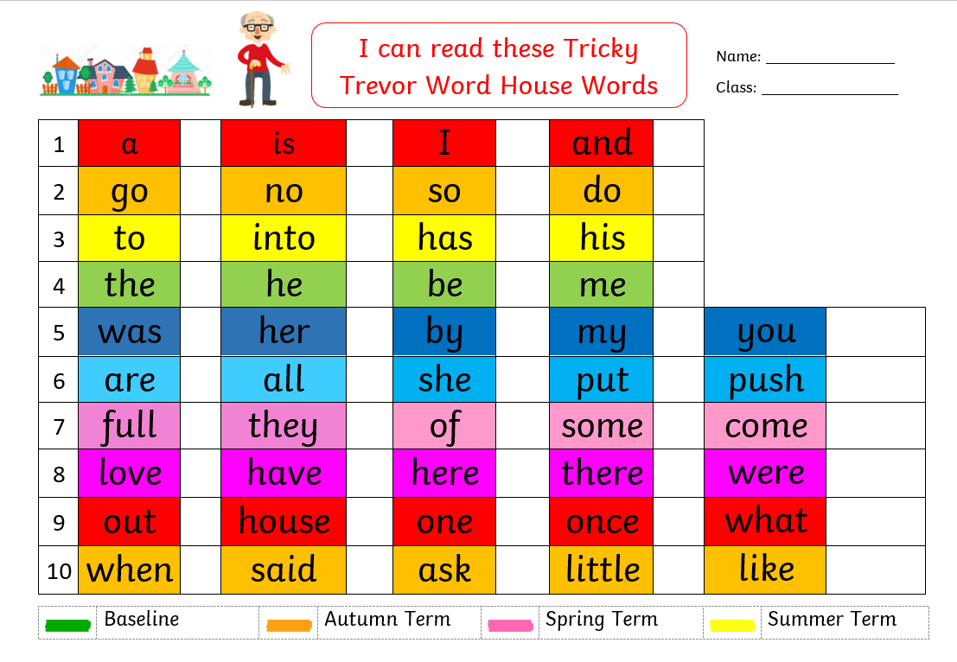

Slide 8

Reading
Your child's reading has been assessed and they have received a green Reading Journal.
Books will be changed on Thursdays. They will receive either one or two phonics books to read with you at home as well as a sharing book from the wing library.
Children will be required to place their reading journal into a separate box and it will be checked and initialled by an adult every week.
Your child’s teacher and teaching assistant will listen to your child read often. This could be individually, in a small group or as part of whole class reading sessions.

Slide 9
Reading
It has been proven that parents are the most important
reading role models for children and young people.
Please continue to read daily at home with your child for at least 10 minutes every day.
There is also an optional section for your children to complete in their green journals should they wish to draw or write about a book they have read.
We hope the children will enjoy taking part in the academies reading challenge this year. This can be done with books from
school or home. Please record these in your child’s reading
journal. Reads will be counted every Friday and rainbow, bronze, silver and gold awards will be presented to children when they achieve these reading goals.

Slide 10
Reading
When reading with your child at home please focus on some of these areas:
Fluency
Expression
Discussion of the text and individual words and phrases
Questions about the story, including inferred questions.
Examples of all these are on the website in the Parent Hub section
But most importantly enjoy the story together!

Slide 11
Handwriting
In Year 1 we are introducing teaching the children to pre-cursive handwriting. This will benefit them in:
Improved Fine Motor Skills: Pre-cursive writing involves continuous, fluid movements that help children develop fine motor skills and hand-eye coordination.
Prevents Letter Reversals: It can reduce common letter reversals, such as confusing ‘b’ and ‘d’, because the letters are connected and flow naturally.
Enhanced Reading and Writing Skills: The connected letters in pre-cursive writing help children understand that sounds are connected to form words, which is a fundamental aspect of reading.
Ease of Transition: Pre-cursive writing can make the transition to cursive writing smoother, as children are already familiar with the basic strokes and connections ready for Year 2.

Slide 12
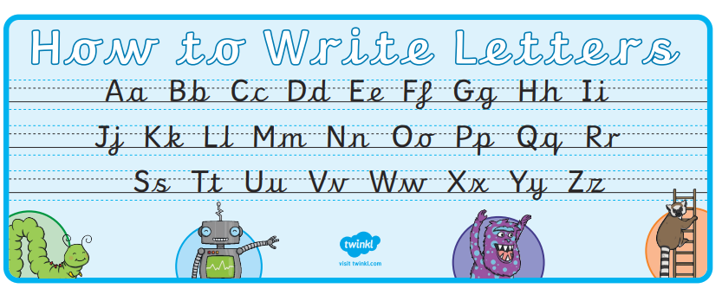

Slide 13
Mathematics
We have been working on embedding a Maths Mastery approach across the Academy linked to the NCETM.
This year we are taking part in the updated mastering number project across the school. This aims to secure firm foundations in the development of good number sense. The aim over time is that children will leave KS1 with fluency in calculation and a confidence and flexibility with number.
We use many resources such as; Rekenrek, number lines, Multilink and Numicon to help support learning.
Maths challenges will continue to be sent home every fortnight. They will be sent via Tapestry each fortnight. These aim to support your child’s mathematical development.

Slide 14
Green Wing Assessments
Children are assessed and their progress monitored regularly by class teachers. This enables us to ensure that all children are making progress and that the next steps in their learning are planned for.
Children will be assessed by indicating their progress and achievement against Year Group Expectations. The annual Phonics Screening Check for Year 1 will take place in June – more details will follow later in the year.
We will hold parent consultation evenings in the Autumn and Spring Term and you will receive a report at the end of the Summer Term.

Slide 15


Tapestry
It is really supportive of our assessments and allows us to see how children are applying their learning from the Academy to what they do at home.
We always love to share any experiences and memories or achievements etc from home. We ask that these be shared via Tapestry rather than being sent into classes unless arranged with your child’s class teacher.
You will still be able to see your child’s learning on Tapestry, please do comment on the pictures and videos that we upload.
If you do not have time to comment but have seen
the upload please click the ‘like’ button so we
know it has been seen.

Slide 16
How are children supported in their learning in Green Wing?
Each class teacher plans and differentiates work to meet the needs of every child. They provide supported and extended activities to enable the children to meet and exceed their potential.
A range of groups are provided, dependent on the needs of the children. These include: Mathmagicians, support from our ELSA and Thrive Practitioners and small group class interventions to either extend or support where necessary.

Slide 17
Behaviour
At The Southwater Infant Academy we believe that positive behaviour management:
  Is value led
  Sets high expectations
  Establishes and maintains clear boundaries
  Rewards positive behaviour
  Uses reasonable consequences and restorative justice
The Academy Values are known and respected by the school community and are displayed in each classroom and throughout the academy. They are taught in assemblies and throughout the RSHE programme and are revisited with the children at every opportunity.

Slide 18
Rewards
At Southwater Infants all members of staff recognise, model and celebrate the academy values at all times around the academy through informal and specific praise. Wherever possible, children’s best efforts will be celebrated through praise, display and performance.
Consequences of inappropriate behaviour and poor choices
At Southwater Infants we recognise that there are, on occasion, times that mistakes can and will be made. The children are learning their way in the world and will need help and guidance at times. Our aim is to be proactive in supporting children to learn from mistakes and take ownership of their own choices. This may mean accepting a consequence for these actions.
At Southwater Infants we use a restorative approach to resolving and repairing conflict and tackling challenging behaviour. All consequences have a learning outcome and aim to teach children that there are always repercussions for poor choices and inappropriate behaviour. Our goal is to help the children learn to make informed and positive decisions and to choose a better way.

Slide 19
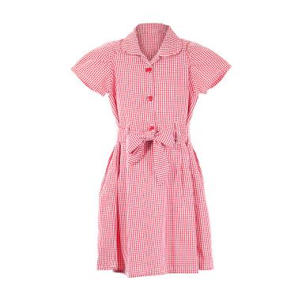
Free School Meals and Pupil Premium
The government has announced that the eligibility criteria for free
school meals will change from 1 September 2026.
All children who live in a household that receives Universal Credit can
get free school meals.
There will be 2 types of benefits-related free school meals (FSM).
Targeted free school meals
Children can get targeted free school meals if their household receives Universal Credit and earns £7,400 a year or less.
Children who receive targeted free school meals can also:
take part in the Holiday Activities and Food (HAF) programme
help our school receive extra Pupil Premium funding
Expanded free school meals
Expanded free school meals are for children whose household receives Universal Credit but does not qualify for targeted free school meals.
Children in this group can receive free school meals, but they cannot access the extra support linked to targeted free school meals.

Slide 20
Free School Meals and Pupil Premium
Targeted free school meals in all schools and academies are available to pupils in receipt of, or whose parents are in receipt of one or more of the following benefits:
Universal Credit
Income-based Jobseeker's Allowance
Income-related Employment and Support Allowance
Support under Part VI of the Immigration and Asylum Act 1999
The guaranteed element of state Pension Credit
Once your child has a free school meal status, either Targeted FSM or Expanded FSM, they will keep that status until the end of that school year.
Your child's eligibility will be checked by West Sussex every year before the start of the new school year. If West Sussex do not have the information they need, they may ask you to provide updated details.
If your child does not qualify for benefits-related free school meals, they can still get Universal Infant Free School Meals (UIFSM).
If your child receives UIFSM and also qualifies for Targeted FSM, it is important to register for Targeted FSM.
Registering helps our school claim pupil premium funding. This extra funding gives the additional funding to support your child with their learning and wellbeing. We can help with uniform, clubs, trips and visits, and classroom support. The application process is really simple, and we can help if you get stuck with it.

Slide 21
House Keeping
Hot meals are available free for every child.
Please visit the Easy Lunch website to view the current menus and book your meal choices.
You will need your school grid username and password. If you do have this please contact the office.
www.theeasylunchcompany.co.uk
If your child brings a packed lunch from home, please ensure you only include healthy food in your child’s lunchbox, no sweets or chocolate. Please note we are a nut-free school.

Slide 22
House Keeping
Each class will have 2 PE sessions per week. On these days children need to come to the academy dressed in their PE kit. If the weather is cold, please can children wear jogging bottoms and academy hoodie or fleece. Children need to be wearing trainers. Please either tape ears or remove any earrings on PE days.
PLEASE NAME EVERYTHING.
Don’t forget that the Academy office opens at 8.30am. If your child is going to be late or absent for any reason, please ring the Academy office after this time so that the class teacher can be informed, or you can email the academy office to let us know.
Please remember that holidays during term time will not be authorised.

Slide 23
Parent Overviews
We will upload a ‘Parent Overview’ to the school website each week under the 'Parent Hub' section which will give you an idea of the learning planned for each area and allow you to support at home.

Slide 24
Fundraising
We are always incredibly grateful for any help in providing our children with the best possible resources to enhance their learning experiences.​
We have an Amazon Wish list, items for each year group can be found here ​http://amzn.eu/7LFxzGp
The PTFA always welcomes help with any fundraising initiatives that they run. Parents and carers can be involved in lots of different ways, so please do get in touch with them if you are able to spare even a few minutes of your time. The funds the PTFA raise are vital in ensuring we can continue to provide resources and experiences to enhance and improve the children's learning.

Slide 25
Thank you
Thank you so much for your ongoing support. We look forward to a fantastic year with your children in Green Wing!
If you are interested in helping out in school with reading, or any other activities please speak to your child’s class teacher as we are always eager for any support. We can arrange for you to have a DBS check with the office.
As always if you have any questions or concerns, please arrange a time to speak with your child's class teacher by phoning the office or arranging a suitable time with the class teacher at the classroom door.

