Slide 1

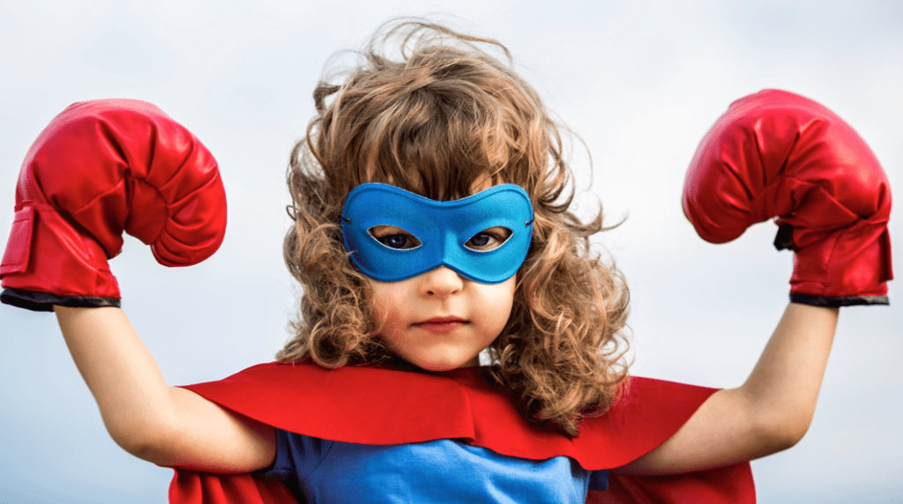
Southwater Infant Academy
Learning Powers

Slide 2
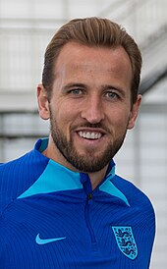
Relationships
Listen
Take turns
Learn from others
Compromise
Collaborate
Share
Harry Kane – Professional Footballer
Harry currently plays for Bayern Munich. He is a prolific goal scorer and one of the best strikers for his generation. He became England’s team captain in 2018.

Slide 3
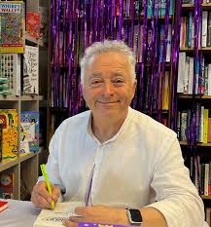

Reflectiveness
Changes
Enjoy learning
Keep improving
Understanding self
Adapting
Planning
Frank Cottrell-Boyce– Author and Screenwriter
Frank is currently the Children’s Poet Laureate for 2024-2026.
Frank will work closely with Book Trust, the UK’s largest children’s reading charity, to promote the importance of reading and ensuring that children have access to wide range of books and stories.

Slide 4
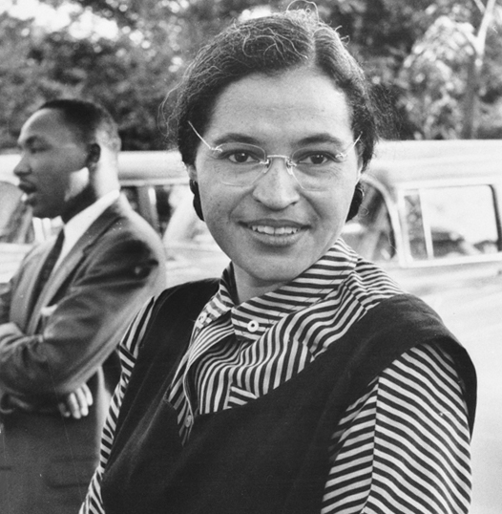
Resourcefulness
Confidence
Using imagination
Explore
Curious
Problem solving
Try it out
Rosa Parks – African American civil rights activist.
In December 1955, Rosa Parks refused to give up her bus seat to
a white man. Her actions inspired the leaders of the local Black community to
fight for their rights. Parks became a nationally recognized
symbol of dignity and strength.

Slide 5
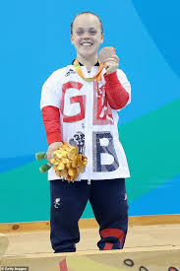
Resilience
Determination
Concentrate
Never give up
Believing
Growth mindset
Trying our best
Ellie Simmonds – British Paralympian
Ellie has dwarfism, her arms and legs are short but her body
is of a normal length. She has won a total of 26 gold medals
whilst competing in the Olympics, World Championships
and European Championship swimming events.

