Slide 1
Assessment and Supporting Learning in Year 2
The Southwater Infant Academy

Slide 2
Aims
Inform you of the assessment procedures that take place at the end of Year 2.
Provide you with information about what the expectations for Year 2 look like in Reading, Writing and Maths, and suggest ideas for supporting your child with their learning.

Slide 3
What is Assessment looking for?
The National Curriculum teacher assessments and tests at the end of Key Stage 1 have been designed to give you, and the
Academy, information about
how well your child is doing.

Slide 4
Teacher Assessments
At the end of Key Stage 1 your child’s teacher will formally assess their performance. This assessment is used along with the National Tests to measure your child’s progress and attainment.
Of course your child’s teacher will be informally assessing their learning at other times (almost daily), in order to plan future teaching.

Slide 5
Teacher Assessment and Tests
Teacher Assessment at the end of Key Stage 1 covers:
Reading
Writing
Maths
Science
Key Stage 1 tests cover:
Reading
Maths

Slide 6
Reading Expectations and Behaviour
Expected Standard:
read accurately most words of two or more syllables
read most words containing common suffixes (e.g. ly, -ful, -ing, -ness)
read most common exception words
read most words accurately and fluently, to allow them to focus on their understanding rather than on decoding individual words
sound out most unfamiliar words accurately,
without undue hesitation
check reading makes sense to them, correcting any
inaccurate reading
answer questions and make some inferences
explain what has happened so far in what they
have read

Slide 7
Greater Depth within the Expected Standard
The pupil can, in a book they are reading independently:
make inferences
make a plausible prediction about what might happen on the basis of what has been read so far
make links between the book they are reading and other books they have read

Slide 8
What can you do at home?
Continue to read daily with your child.
Ask questions about the book you have read with your child – particularly with their sharing book.
Discuss interesting vocabulary choices and the meanings of any new vocabulary.
Continue to support the children in learning the common exception words and practising phonics – both reading and writing.

Slide 9
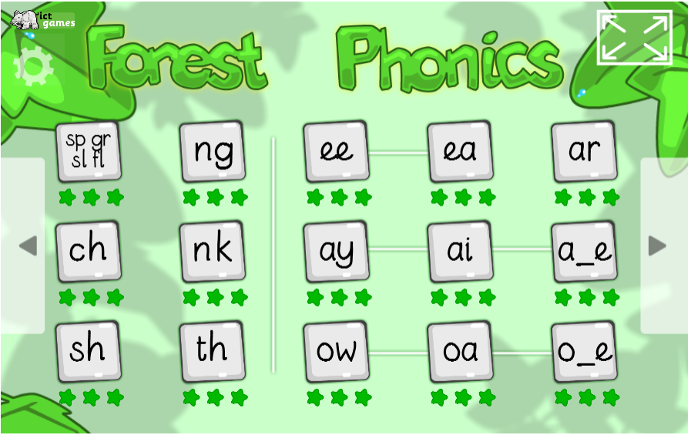
Useful Websites
phonicsplay.co.uk
selection of interactive games for all phonic phases. Mostly simple games
phonicsplaycomics.co.uk
generates comics online to support reading of specific phonic phases
ictgames.com/mobilePage/literacy.html
a great selection of games
that practise phonics and
spellings across KS1

Slide 10
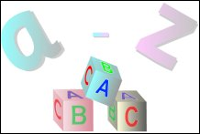
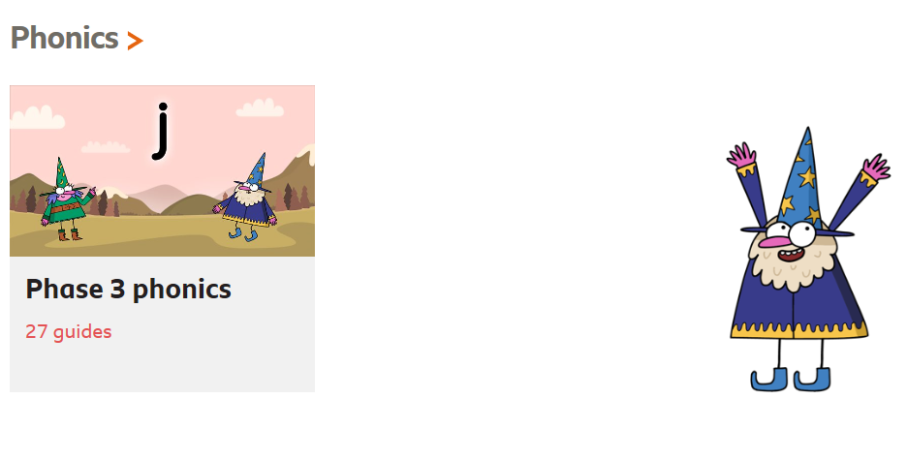

Useful Websites
letters-and-sounds.com
printable resources for each of the
Letters and Sounds phonic phases,
also links to games aligned with each phase
bbc.co.uk/bitesize/subjects/zgkw2hv
activities for grammar, punctuation,
spelling and phonics
Teachyourmonstertoread.com
Reading games on computer or
mobile device to help children
learn to read

Slide 11
Writing Expectations and Behaviour
Expected Standard:
write simple coherent narratives
write about real events
use capital letters and full stops correctly, and question marks when required
use the past and present tense mostly correctly and consistently
use co-ordination and subordination
spell many words correctly, with phonetically plausible attempts at others
spell many common exception words
form letters, including capital letters
and digits, correctly
remember clear finger spaces

Slide 12
Greater Depth within the Expected Standard
write for different purposes, using their reading to help them
make simple additions, revisions and proof-reading corrections to their writing
spell most common exception words
add suffixes to spell words correctly (e.g. –ment, -ness, -ful, -less, -ly)
greater range of punctuation –
exclamation marks, commas in lists, apostrophes
join some letters when writing

Slide 13
Using co-ordination (or/and/but) Using some subordination (when/if/that/because) | When she could speak she crawled to the castle and knocked quickly but nobody answered. Can you sell Daisy because she is too old and in return get some money? When she arrived, her mum was furious and she was so stubborn with Poppy. When we were climbing, we had to hold our clipboard in our left hand and hold on to a long rope in our right hand. Put a pin in the middle so the bits that you fold don’t explode and you have to do it again. I adore Tuffy because every second that Tuffy speaks it makes me think that if I was an author when I grow up, I would be an author just like that.

Slide 14
Suffixes and Common Exception Words
-ing. –ed, -er, -est, -y,
hiking, hiked, hiker, nicer, nicest, shiny
-ment, -ness, -ful, -less, -ly
Enjoyment, merriment, sadness, happiness, careful, playful, hopeless, penniless, badly, happily
door, floor, poor, because, find, kind, mind, behind, child, children, wild, climb, most, only, both, old, cold, gold, hold, told, every, everybody, even, great, break, steak, pretty, beautiful, after, fast, last, past, father, class, grass, pass, plant, path, bath, hour, move, prove, improve, sure, sugar, eye, could, should, would, who, whole, any, many, clothes, busy, people, water, again, half, money, Mr, Mrs, parents, Christmas

Slide 15
Maths Expectations
Expected standard:
read scales in divisions of ones, twos, fives and tens
partition any two-digit number into different combinations of tens and ones, explaining their thinking verbally, in pictures or using apparatus
add and subtract any 2 two-digit numbers using an efficient strategy, explaining their method verbally, in pictures or using apparatus
e.g. 48 + 35; 72 – 17
recall all number bonds to and within 10 and use these to reason with and calculate bonds to and within 20
e.g. If 7 + 3 = 10, then 17 + 3 = 20;
if 7 – 3 = 4, then 17 – 3 = 14;
leading to… if 14 + 3 = 17, then 3 + 14 = 17,
17 – 14 = 3 and 17 – 3 =14

Slide 16


Maths Expectations
Expected standard (cont.):
recall multiplication and division facts for 2, 5 and 10 and use them to solve simple problems
identify ¼, , ½, , ¾, of a number or shape, and know that all parts must be equal parts of the whole
use different coins to make the same amount
read the time on a clock to the nearest 15 minutes
name and describe properties of 2-D and
3-D shapes, including number of sides,
vertices, edges, faces and lines of
symmetry.

Slide 17
Greater Depth within the Expected Standard
read scales where not all numbers on the scale are given, and estimate points in between
recall and use multiplication and division facts for 2, 5 and 10 and make deductions outside known multiplication facts
use reasoning about numbers and relationships to solve more complex problems and explain their thinking (e.g. 29 + 17 = 15 + 4 + ; ‘together Jack and Sam have £14. Jack has £2 more than Sam. How much money does Sam have?’ etc.)
solve unfamiliar word problems that involve more than one step (e.g. ‘which has the most biscuits, 4 packets of biscuits with 5 in each packet or 3 packets of biscuits with 10 in each packet?’)
read the time on a clock to the nearest 5 minutes
describe similarities and differences of 2-D and 3-D shapes, using their properties (e.g. that two different 2-D shapes both have only one line of symmetry; that a cube and a cuboid have the same number of edges, faces and vertices, but different dimensions)

Slide 18
Maths ideas to try at home
Play games such as Snap, Bingo, Pairs or board games with your child. You can create your own games too.
Sing number songs and rhymes.
Sort, count, match and compare everyday things.
Encourage your child to help you with everyday things, such as laying the table. Ask them how many plates / chairs / knives / forks will be needed. Let them help with measuring and weighing.
Read the TV guide together and plan what to watch.
Encourage them to use a clock regularly to relate times to routines and activities.
When you go shopping, point out prices. Let them pay for things and choose the coins to use.
Read bus and train timetables together.
Use appropriate language to describe positions, sizes and measurements – over / under, in front of / behind, heavier / lighter.
Try to make learning of facts fun e.g. using times tables song CD’s in the car.
ictgames.com also has maths games to play

Slide 19
Assessment at the end of Year 2
Assessment at the end of KS1 is reported through teacher assessment.
Tests are carried out during May, on days and times that the academy chooses, to inform and support teacher assessment.
Phonics Screening tests will be carried out in June for all children who did not pass in the Autumn Term.
Teacher assessment will be based on your child’s everyday achievement in the classroom.
It is essential that children are in the Academy during May and June unless they are ill or there are exceptional circumstances.

Slide 20
What will happen for the tests?
Relaxed classroom.
The children will not be told they are being tested.
The children are asked to try their best.
The children are encouraged to use mathematical strategies that they have learnt.
No surprises
The children will be familiar with the style of questions.
Bright colourful booklets.
Please don’t tell the children they will be doing tests!

Slide 21
Teacher Assessment
Assessment is ongoing, and judgements are made using a range of evidence
Learning is assessed against the learning and success criteria given to the children
Formative assessment strategies enable children to receive feedback and make improvements in every lesson
Children’s progress is tracked and discussed regularly using an academy tracking system

Slide 22
Reporting Results
Children will be assessed according to the expectations for the year group:
Pre Key Stage Standard 1 - 4
Working towards the expected standard
Working at the expected standard
Working at greater depth within the expected standard
For Science children are assessed as either
Working at the expected standard or
Not met the expected standard

